Slide 1
Journalism & Civic Engagement
Dr. Yue (Nancy) DAI
Department of Media and Communication

Slide 2
Civic Engagement
公民參與
Journalism

Slide 3
Civic Engagement
Journalism
Professional Journalism
Citizen
Journalism

Slide 4
Learning Objectives
Develop a good understanding of civic engagement, including its conceptualization, significance and forms
Understand the concept of fourth estate（產業） and the traditional perspective of journalism
Describe how both citizen journalism and professional journalism in the digital era help shape civic engagement

Slide 5

Civic Engagement - Background
The Forms of Capital (1986)
Economic capital （基礎設施）
Command of economic resources (money, assets（資產）, property)
Cultural capital
A person‘s education (knowledge and intellectual （知識分子）skills) that provides advantage in achieving a higher social-status in society

Slide 6
Civic Engagement - Background
The Forms of Capital (1986)
Social capital
Actual and potential resources linked to the possession of a durable（持久） network of institutionalized relationships of mutual acquaintance （相互認識）and recognition
Symbolic capital (added later)
Can be referred to as the resources available to an individual on the basis of honor, prestige（威望） or recognition, and serves as value that one holds within a culture

Slide 7

Practically speaking…

Slide 8
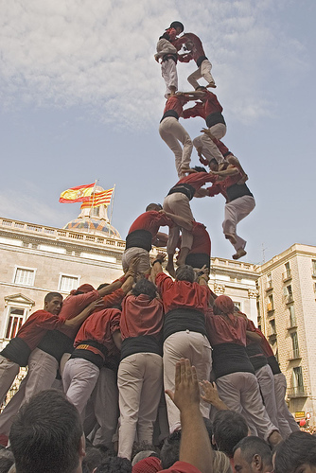
Social capital provides:
Information
Influence and control
Social solidarity（團結一致）

Slide 9
Civic Engagement - Background
Social capital: Comprised（由以下部分組成） of social structures and actions between people within the social structures, based on trust and expectation of reciprocal（對等） treatment.
The existence of social capital is exhibited by networks, norms（準則）, and trust among individuals, which enable them to work together to pursue common goals.

Slide 10
Civic Engagement - Background
Social capital facilitates co-operation within and among groups by providing networks with shared norms, values and understanding.
Social capital is manifested（體現了） through different aspects of civic engagement and social networks

Slide 11

Civic Engagement
Any activity, individual or collective（集體） actions, designed to identify and address issues of public concern
Central idea:
Ordinary people become the
agents of social change

Slide 12
Civic Engagement
Why does it matter?
It develops and strengthens the communication between the decision-makers and the ones who get affected

Slide 13
“The health of a democratic society may be measured by the quality of functions performed by private citizens.”
-- Alexis de Tocqueville
Democracy in America

Slide 14
Civic Engagement
Why it matters?
It develops and strengthens the communication between the decision-makers and the ones who get affected
Other reasons:
Resource is limited
Public's loss of confidence in government in general
Complicated（複雜的） problems require complicated solutions

Slide 15
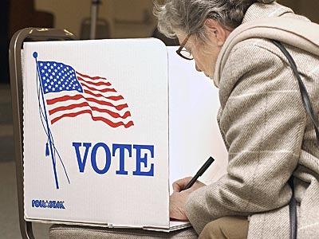
Civic Engagement
Takes many forms:
Donating /giving - volunteering political campaigns
Participating in an informal/neighborhood association - writing to an elected official
One of the most apparent forms --Voting

Slide 16
Civic Engagement
Civic Health measured by looking at five key area:
Service
Group participation
Connecting to information and current events
Social connectedness
Political action
Source: Civic Life in America

Slide 17


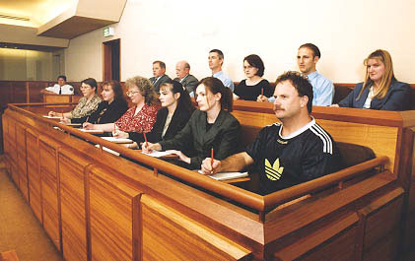
Service
Formal or informal volunteering
Jury（陪審團） duties

Slide 18
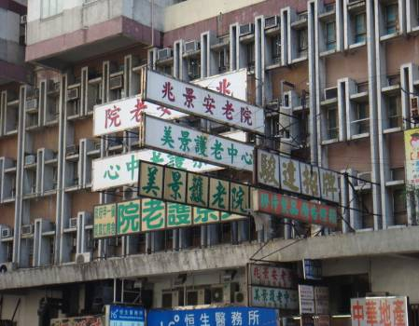
Service
Formal or informal volunteering
Jury duties
Community works
Other social works (religious, charity, youth-school, health, or culture-arts)
Community Service Orders (CSO) for law offenders

Slide 19
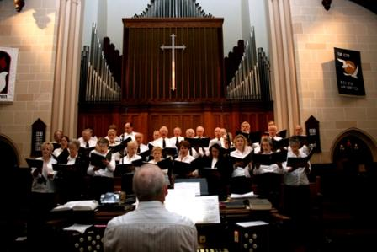

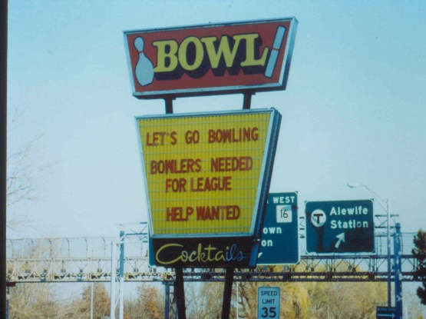
Group participation
Sports or recreational（休閒） groups
Service or civic associations
School, neighborhood, or community groups
Church（教會） or religious groups

Slide 20

Connecting to Information & Events
Pay attention to news reports on civic issues
Become informed about government’s officials and activities
Participate in political discussions

Slide 21

Social Connectedness
Talking to friends and family
Have dinners with other household members
Talking to neighbors
Exchanging favors with neighbors
Making friends with people very different background
Source: The Commission on Youth (2010)

Slide 22
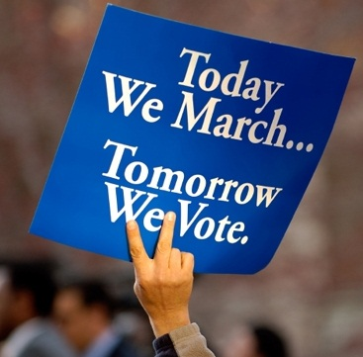
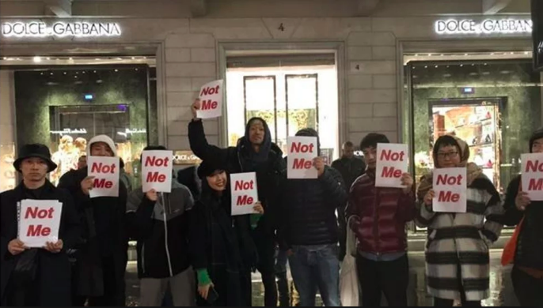
Political Action
Supporting a party or a candidate
Participating in a demonstration（示威）
Contacting a public official（公職人員）
Buying or boycotting based on values

Slide 23
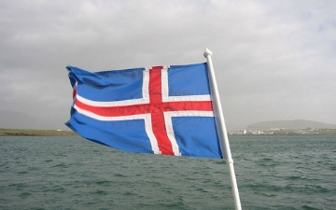
Note that these five areas are NOT mutually exclusive（相互排斥）
An example of crowd-sourced constitution proposal in Iceland in 2012
A group of 25 citizens presented a draft of the constitution to Iceland’s parliament. The group, which is made up of ordinary residents, compiled the document online with the help of others. The constitution council posted the first draft in April on its website and then let citizens comment via a Facebook Page. The council members are also active on Twitter, post videos of themselves on YouTube and put pictures on Flickr.

Slide 24
Perspectives on Civic Engagement and Its Relationship with Media

Slide 25

Pessimistic（悲觀的） Trends in America Back in 1980/90s
The decline（衰退） of civic engagement
Voting: Only 60% registered and 58% voted
Participation in any types of social groups/associations fell significantly
Volunteering work increases slightly, but mainly on a micro-level
Pay less attention to the news
College graduates know as much about politics as the average high school senior did fifty years ago

Slide 26

Pessimistic Trends in America Back to 1980/90s
The decline of civic engagement
Mass media and modern technology are attacked as promoting social isolation:
radio, television or video games (Time replacement effect)

Slide 27
Counter-Arguments
Cross-national studies suggest that civic engagement changes dynamically across time and contexts
Has nothing to do with the emergence of mass media and new media
Other scholars: civic activities may take different forms. Instead of bowling leagues, people integrate（融入） themselves into social networks and enhance their social capital via other online or offline groups
The 20-year decline in youth voting was ended in the 1992 election due to the establishment（建立） of Rock the Vote

Slide 28
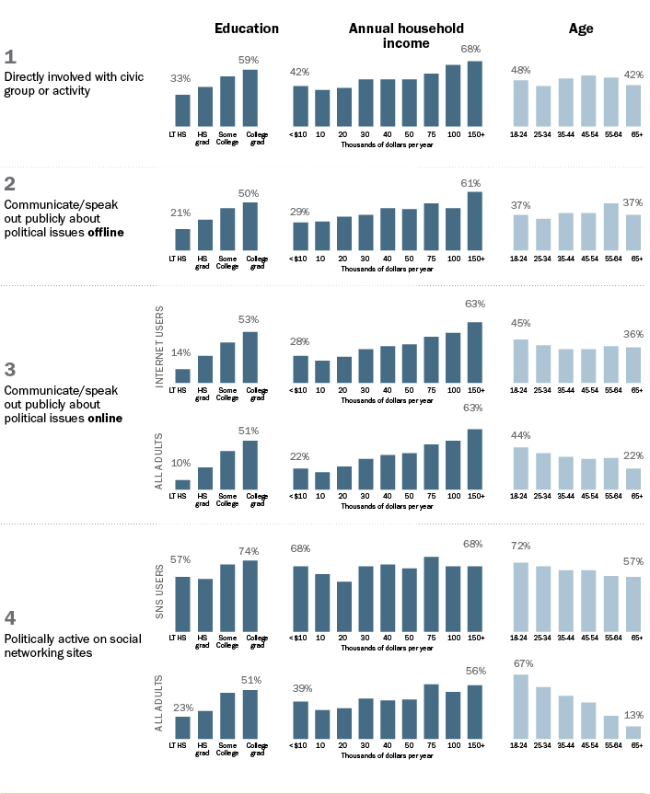
Traditional political activities are most common among the well-educated and financially well-off, regardless of whether online or offline.
On social networking sites, income-related differences are more modest（謙虛） — but civic engagement in these spaces is still most prevalent（盛行的） among those with higher education.
http://www.pewinternet.org/Infographics/2013/Civic-Engagement.aspx

Slide 29
Civic Engagement in the Digital Era
Internet creates more bridges for civic connections and fosters（促進） more civic engagement among people with diverse backgrounds
Counter argument: The internet fosters polarized political views. Why?
Online anonymity（匿名性） promotes disinhibition and flaming
It also creates a space where people easily categorize（歸類） others based on membership to certain social categories (e.g., based on political orientation, gender, etc.) (Reicher et al., 1995)
Existing beliefs are reinforced（強化） in the process of categorizing ingroup and outgroup members

Slide 30
Civic Engagement in the Digital Era
While the internet has proven to be a tool for staying in touch with communities, political organizations, aiding disaster relief efforts, and spurring（帶動） movements, its complex impact on civic engagement is yet to be fully understood.

Slide 31
Civic Engagement in the Digital Era（時代）
Concerns about democracy in the digital age: Technology empowers the powerful more than it does the underpowered
Internet pioneer and technology administrator predicts that by 2030, as much of 75% of the world’s population will be enslaved（被奴役） by artificial intelligence-based surveillance（監測） systems developed in China and exported around the world.
“Governments (and their corporate partners) are broadly using technology to create a surveillance state, and what amounts to law by unaccountable black-box algorithm（算法）…” – Dan Gillmor (Professor of Practice, Arizona State University)

Slide 32
Civic Engagement in the Digital Era
The controversial case of Facebook’s fake accounts allegedly tempering with local politics, among other alleged misconducts（指控的不當行為）
Speech from and interviews with the whistleblowers（檢舉人） for Facebook’s questionable conducts
https://www.youtube.com/watch?v=L3cG3cLXHfk&ab_channel=CNBCTelevision
https://www.youtube.com/watch?v=-rlQbZRJtWw&ab_channel=ABCNews%28Australia%29

Slide 33
Internet and Civic Engagement of Youth in HK
1. Hong Kong youth learn about civic activities and civic events mainly through social media (mostly Facebook) and TV
Source: Youth Political Participation and Social Media Use in Hong Kong Research Report
N = 829, aged 15-29

Slide 34
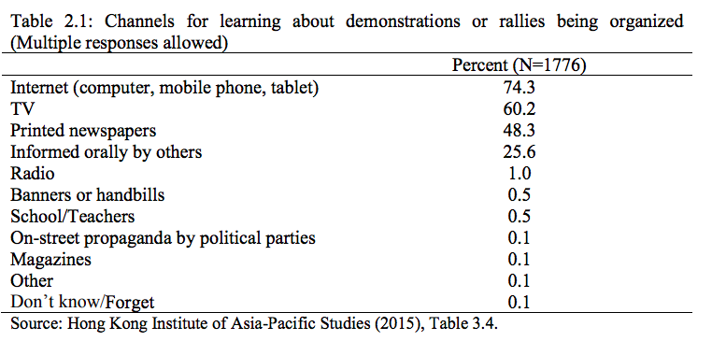
Internet and Civic Engagement of Youth in HK

Slide 35
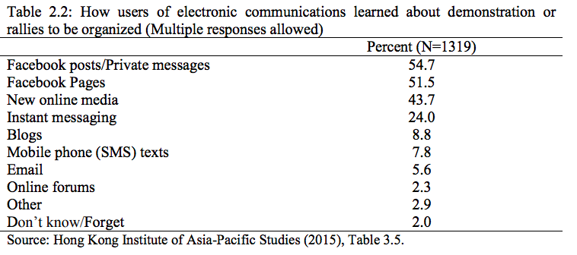
Internet and Civic Engagement of Youth in HK

Slide 36
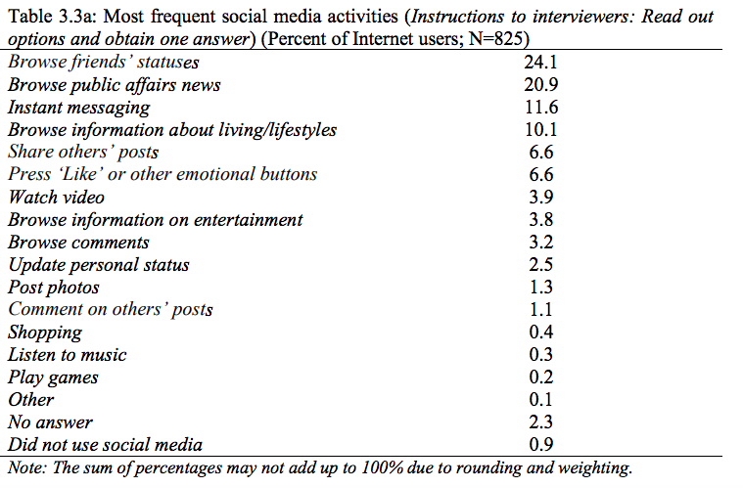
Internet and Civic Engagement of Youth in HK
Social network

Slide 37
Internet and Civic Engagement of Youth in HK
2. In general, the youth in HK is unsatisfied with the government. Most do not trust the government. This is particularly the case for those who consume major public affairs information from social media.
Source: Youth Political Participation and Social Media Use in Hong Kong Research Report

Slide 38
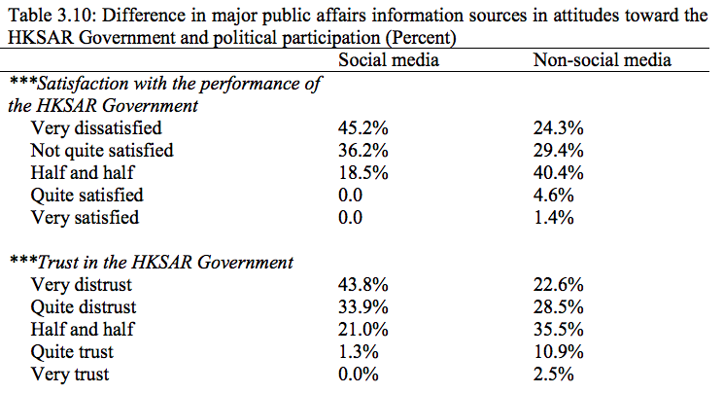

Slide 39
Internet and Civic Engagement of Youth in HK
3. The level of civic engagement of youth in Hong Kong is not high, both online and offline
Source: Youth Political Participation and Social Media Use in Hong Kong Research Report

Slide 40
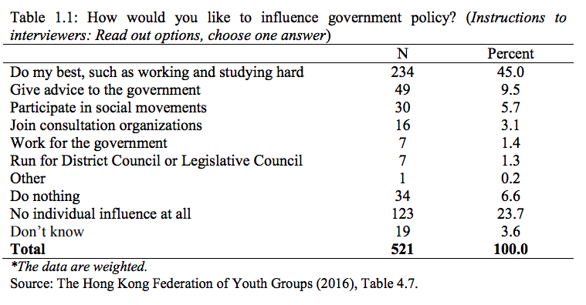

Slide 41
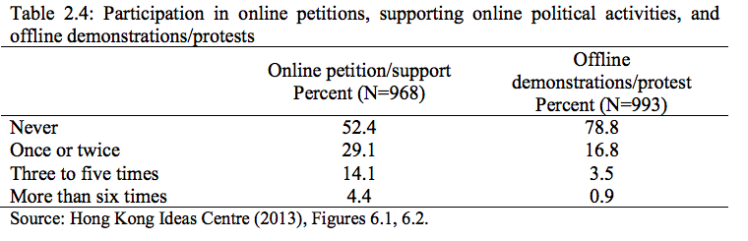

Slide 42
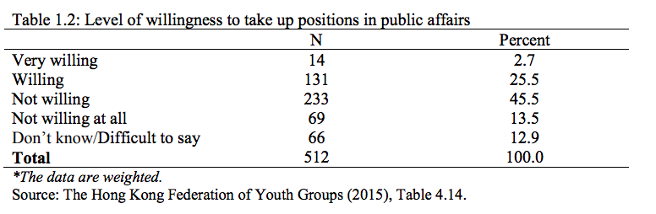
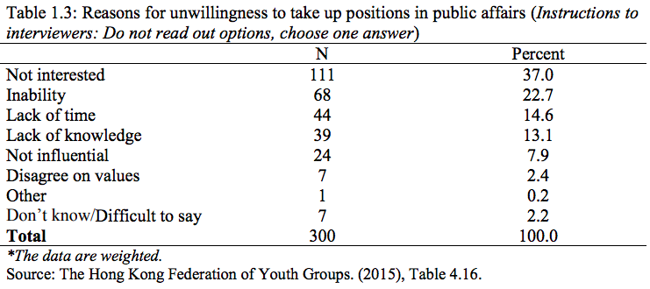

Slide 43
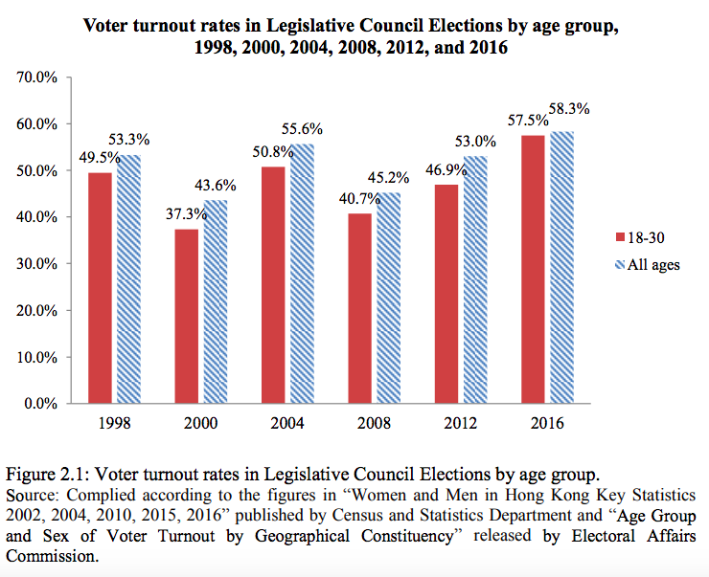

Slide 44
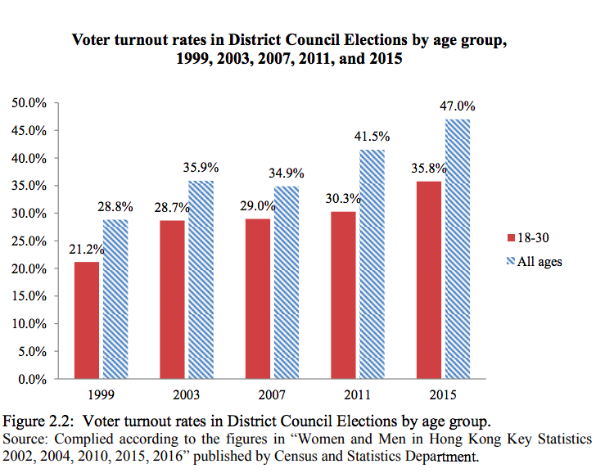

Slide 45
Protests in Hong Kong (2019-2020)
Shek (2020)
The process of introducing the Bill is the “heat” which has ignited（被點燃） the “fuels” represented by pre-existing issues in life quality and well-being（幸福）
The “four strong winds” that intensified（激化） the protest
Disinformation and misinformation
Anonymity of protesters
Public support for the students
Support given by parties outside of Hong Kong
*Notice the role of media in each one of these “winds”

Slide 46
What’s the role of journalism in shaping civic engagement?
Civic Engagement
Journalism

Slide 47
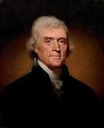
Thomas Jefferson (1787)
Newspapers without government vs. government without newspapers
“The basis of our governments being the opinion of the people, the very first object should be to keep that right; and were it left to me to decide whether we should have a government without newspapers or newspapers without a government, I should not hesitate a moment to prefer the latter. But I should mean that every man should receive those papers and be capable of reading them.”

Slide 48
Media as Fourth Estate
Juridical
法理上的
Executive
行政人员
Legislature
立法机构
Media
“(Edmund) Burke said there were Three Estates in Parliament; but, in the Reporters‘ Gallery yonder, there sat a Fourth Estate more important than they all. Printing, which comes necessarily out of Writing, I say often, is equivalent（相當於） to Democracy: invent Writing, Democracy is inevitable. ..... Whoever can speak, speaking now to the whole nation, becomes a power, a branch of government, with inalienable weight in lawmaking, in all acts of authority. It matters not what rank he has, what revenues or garnitures: the requisite thing is that he have a tongue which others will listen to; this and nothing more is requisite.”
--Thomas Carlyle
(Scottish philosopher, satirical writer, essayist, translator, historian, mathematician, and teacher)

Slide 49
Media as Fourth Estate
Judicial, executive, legislature and media should be separate and independent powers
Mass media (print & broadcasting) are often seen as fulfilling the role of fourth estate because of its indirect power over political systems
The Internet is also considered to have similar functions

Slide 50
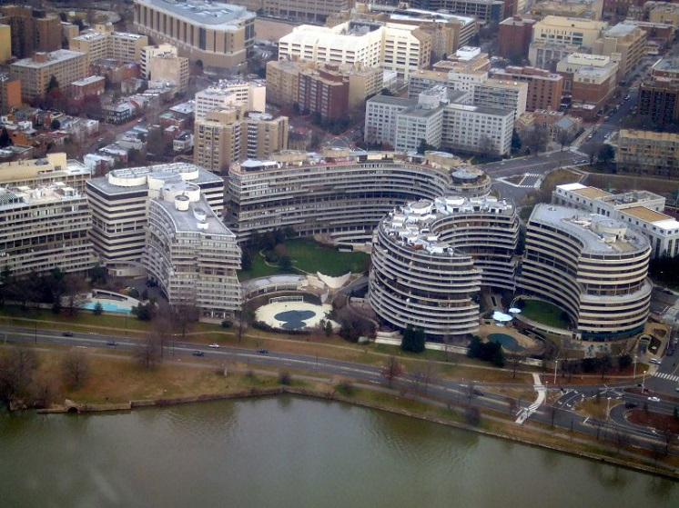
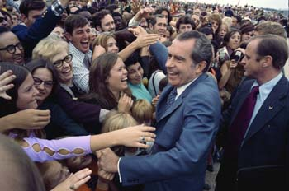
Watergate Scandal (1972)
Mass media oversee the executive power
大众传媒监督行政权力
http://youtu.be/IHnmriyXYeg
http://www.history.com/topics/watergate
Two reporters from Washington Post:
Bob Woodward
Carl Bernstein

Slide 51
Traditional Perspective of Journalism
Civic Engagement
Professional Journalism
Gatekeeper

Slide 52
Traditional Perspective of Journalism
Agenda-setting Theory (McCombs & Shaw, 1972)
News agenda determines the public agenda
People rely on news to decide where they should focus attention (surveillance（監測） function)
Media are distant from the public and decide what they should care about

Slide 53
Traditional Perspective of Journalism
Underlying（基本） assumptions:
Information access = automatic engagement
Awareness leads to public judgment and engagement
Audience is passive
A tunnel（隧道） effect: Source-message-channel-receiver
Linear story-telling
An “if-you-publish-it-they-will-engage” model

Slide 54
Civic Engagement
Journalism
Citizen
Journalism

Slide 55

Challenges from CJ and New Media
1. The rise of network society
Personalized news consumption model (“News is on demand”)
Information flows much faster via interpersonal人際 networks
Twitter has been the go-to platform for real-time reporting and reaching out to sources.
Facebook helps scale（擴大規模） the communication and reaches more public.
Facebook also biases people’s news consumption by exposing individuals to news through their social networks.

Slide 56

Challenges from CJ and New Media
2. Watching the watchdog
People have more participation opportunities:
user-generated content
Changing the passive role:
Audiences are in control of our own learning
fact-checking against mainstream media

Slide 57
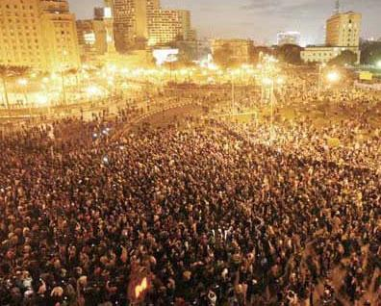

The events of the Arab Spring were enlightened not by journalist but bloggers and tweeters
http://www.theguardian.com/world/interactive/2011/mar/22/middle-east-protest-interactive-timeline

Slide 58

Challenges from CJ and New Media
3. Journalism ineffectiveness
Decline of readership & audience-ship
Increasing keen（激烈的） competition: ( global/national/local/citizen journalism)
Old financial/business models fail
Media: “Trust me” →Audience: “Show me”

Slide 59
Challenges for Traditional Perspective (Professional Journalism)
The rise of network society
Watching the watchdog
Journalism ineffectiveness
Civic Engagement
Professional Journalism
Changes?

Slide 60


Slide 61
A new role for news agency
Cultivate loyal readers忠實讀者 by providing quality journalism
People still go to familiar trusted news brands
People actually read long form journalistic piece from tablets
Advertising-driven revenue（收入） →Subscription-driven revenue
Take advantage of social media when chasing （追蹤）a story

Slide 62



Subscription packages from
SCMP, WSJ, and Financial Times

Slide 63
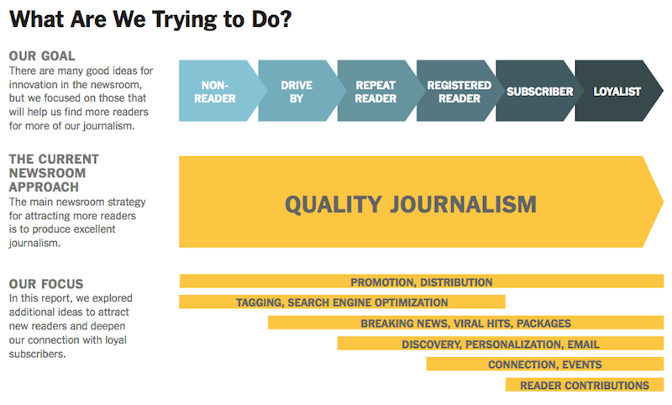
The New York Times’ innovative newsroom strategy

Slide 64
A new role for news agency (Con’t)
Provide the structure and facilitation for effective discourse through interactions with readers
通过与读者的互动，为有效的话语提供结构和便利
How traditional journalism in the digital age can facilitate civic engagement
数字时代的传统新闻业如何促进公民参与

Slide 65
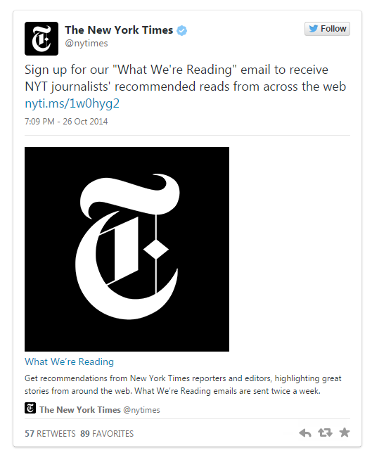

Slide 66
Key Engagement Goals for News Agency
Using interactive tools to present public affairs more effectively
Providing venues for citizen voices linked with the authority and credibility of news organization
Providing places for citizen-to-citizen interactions on public affairs
Providing places for citizen-to-journalist interactions on public affairs
Providing places for citizen-to-official interactions on public affairs

Slide 67
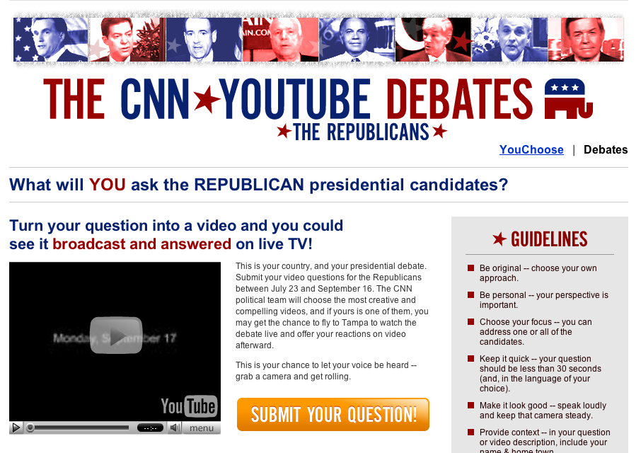
News Organizations Tapping into Citizen Journalism
The CNN / YouTube Debates (2008)
Citizens submitted questions for the presidential candidates to answer in two live debates on CNN
5000+ video submissions
7 Million people tuned in to watch on CNN
Over 9 Million video views on YouTube

Slide 68
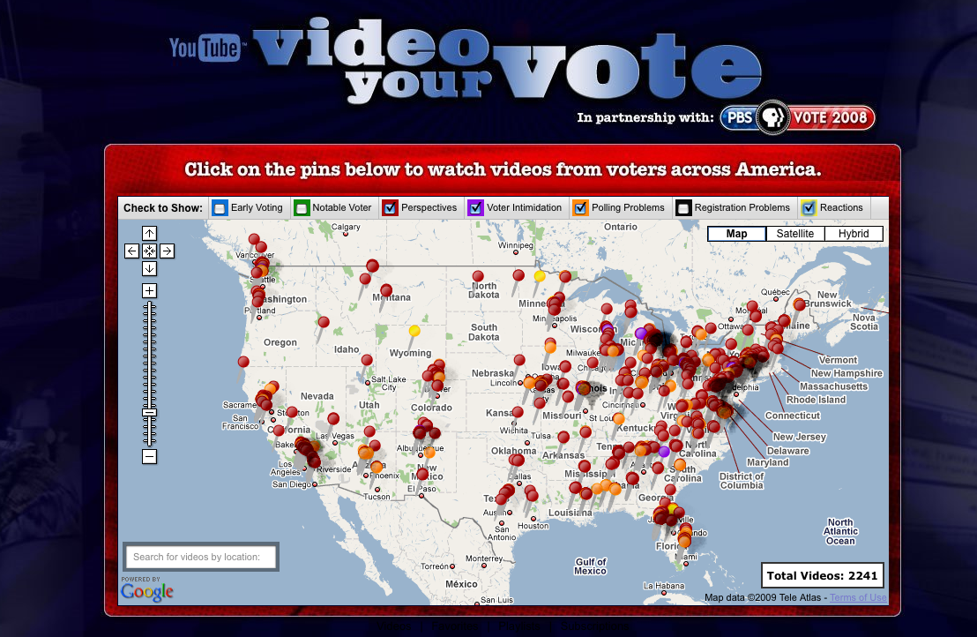
News Organizations Tapping into Citizen Journalism
PBS / YouTube: Video Your Vote
Voters were asked to document their polling places on the Election Day
2500+ video submissions
50 states represented
https://www.youtube.com/user/videoyourvote

Slide 69
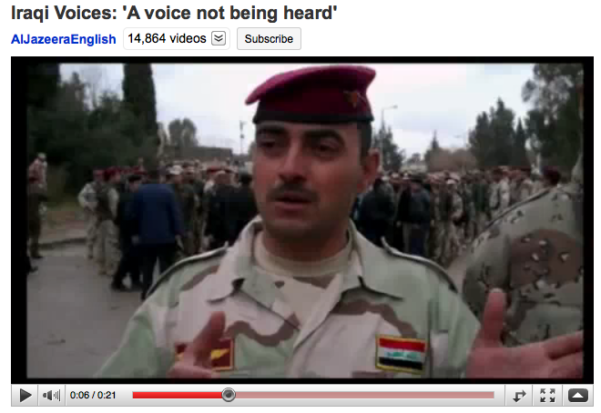
News Organizations Tapping into Citizen Journalism挖掘公民新闻的新闻机构
Al Jazeera:
Al Jazeera invited Iraqi citizens to share their thoughts around the election
They distributed Flip cams and worked with citizen stringers on the ground
The best videos were broadcast on air throughout Al Jazeera’s election coverage

Slide 70
Next Time
Submit your 3rd weekly tweet by Feb 13th, 11:55pm
Post your observations about minority groups (in any society)
Hashtag: #CJMinor
It doesn’t have to be in Hong Kong
Read: Hogg (2009)

